Slide 1
Milestone 3
Michael Melichar

Slide 2

Agenda
Intro

Slide 3

Introduction
The Product Management System is a web application designed to support the management of various products. The application allows users to perform CRUD operations on products, which are represented as objects with multiple properties. The system will consist of back-end services developed using Express and Node.js, a front-end web application built with Angular, and a second front-end application developed using React.

Slide 4
User stories

Slide 5
User Stories
As a user, I want to be able to view a list of products, so that I can see what products are available.
As a user, I want to be able to create a new product, so that I can add new items to the inventory.
As a user, I want to be able to edit an existing product, so that I can update its information if needed.
As a user, I want to be able to delete a product, so that I can remove items that are no longer needed.
As a user, I want to be able to view a list of categories, so that I can see how products are organized.
As a user, I want to be able to create a new category, so that I can group products based on their characteristics.
As a user, I want to be able to edit an existing category, so that I can modify its properties if necessary.
As a user, I want to be able to delete a category, so that I can remove unnecessary groupings.
As a user, I want to be able to view the details of a product, including its properties and associated category.
As a user, I want to be able to view the details of a category, including its properties and the list of associated products.

Slide 6
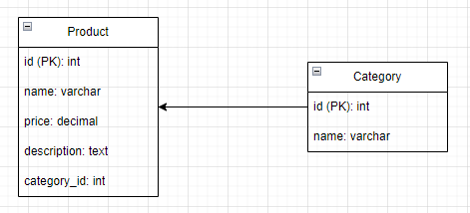
Initial Database Design

Slide 7
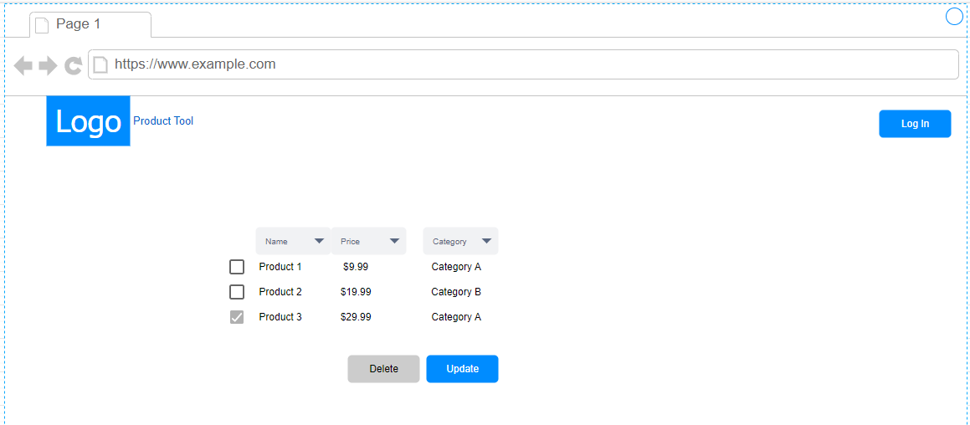
UI Sitemap

Slide 8
UML Classes
Product:
Properties: id, name, price, description, category, quantity
Methods: getters and setters for properties
Category:
Properties: id, name
Methods: getters and setters for properties
DatabaseConnection:
Methods: connect(), disconnect(), executeQuery(), executeUpdate()
ProductService:
Methods: getAllProducts(), getProductById(id), createProduct(product), updateProduct(product), deleteProduct(id)
CategoryService:
Methods: getAllCategories(), getCategoryById(id), createCategory(category), updateCategory(category), deleteCategory(id)

Slide 9
Risks
The project will identify and track unknowns and risks that may arise during development, ensuring appropriate mitigation strategies are in place to address them effectively.
The design report will document all technical decisions and designs, including UML diagrams, ER diagrams, UI designs, and other artifacts necessary to support the end-to-end solution and application design.

Slide 10
API Endpoints
GET /api/products: Retrieves a list of all products in the system.
POST /api/products: Creates a new product based on the provided data in the request body.
PUT /api/products/:id: Updates the product with the specified ID using the data provided in the request body.
DELETE /api/products/:id: Deletes the product with the specified ID from the system.

Slide 11



Challenges
Quite honestly, there’s no reason to front load an assignment like this and then have almost nothing for the rest of the class, but I have it going on in two different classes right now. Meaning I’ve decided to completely ignore the actual implementation for this class and dedicate that time to making a working php app and host it via IIS for my other class. This has been an extremely frustrating series of classes because there haven’t been any instructions on what to do, but rather instructions to do something I have no knowledge of. That’s why I’m taking the class, for instruction.

Slide 12




Thank you
Michael Melichar

